Slide 1

VUE
LOOPS – IF/ELSE

Slide 2

0
WHY VUE ?
1
DATA BINDING
ROADMAP
2
METHODS & EVENTS
3
LOOPS / IF/ELSE
X
VUTIFY
4
COMPUTED & WATCHERS
FINAL
9
AUTHENTICATION
5
CLI
MIDTERM
COMPONENTS
8
SLOTS / WIDGETS
6
7
ROUTING

Slide 3
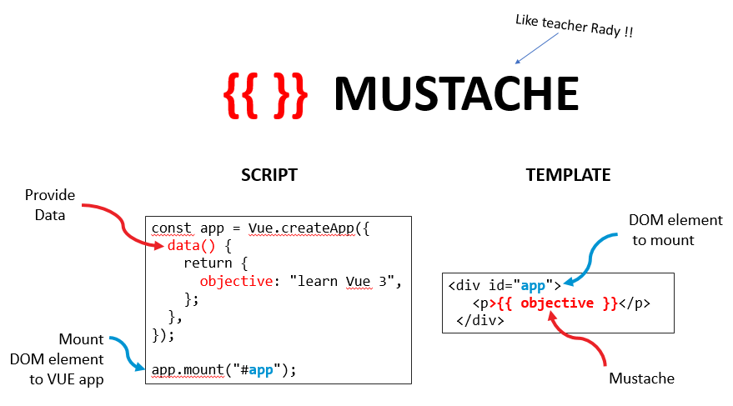
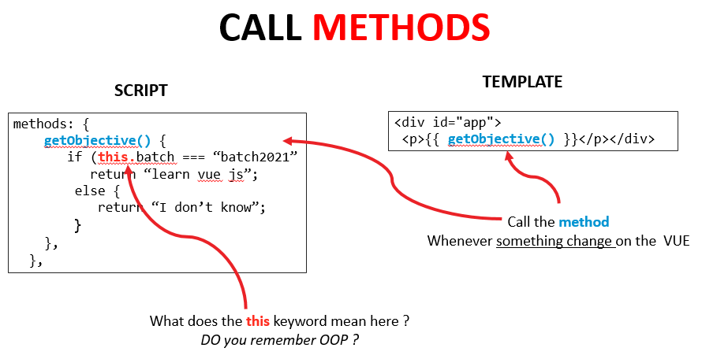
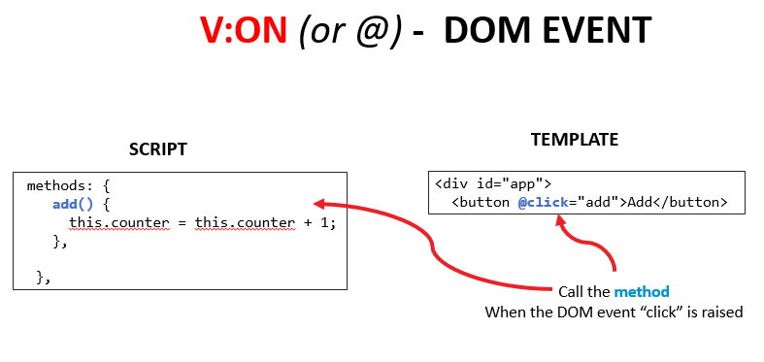
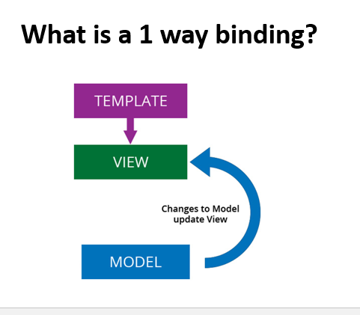
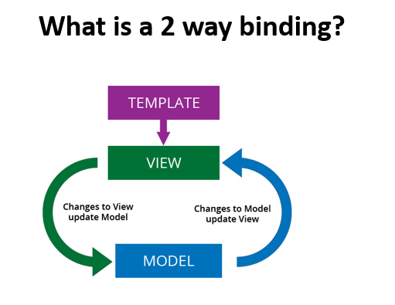
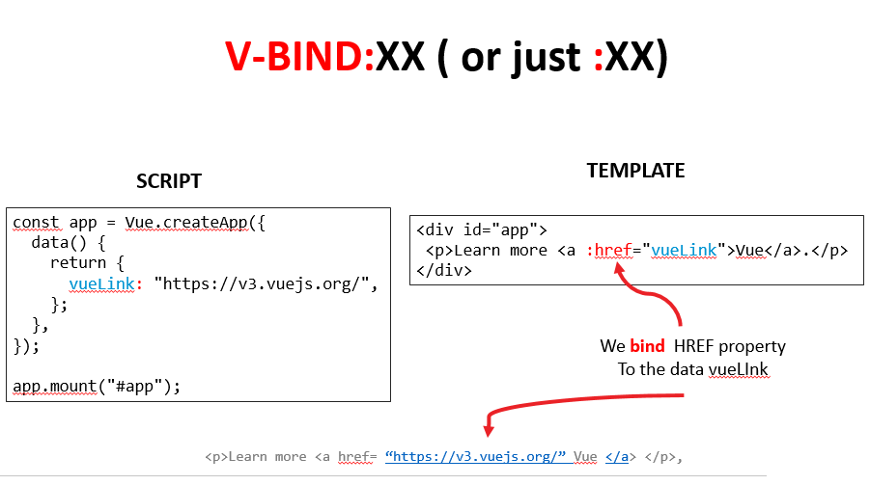
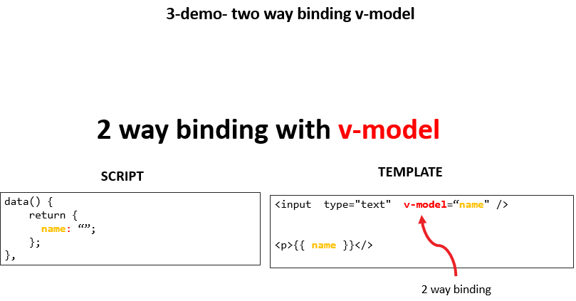
What you know so far

Slide 4


Now, how to do this?
IF <X>
ELSE
Render content conditionally?
Display a list of products, students…
BEST TREE 1
BEST TREE 2
BEST TREE 3

Slide 5


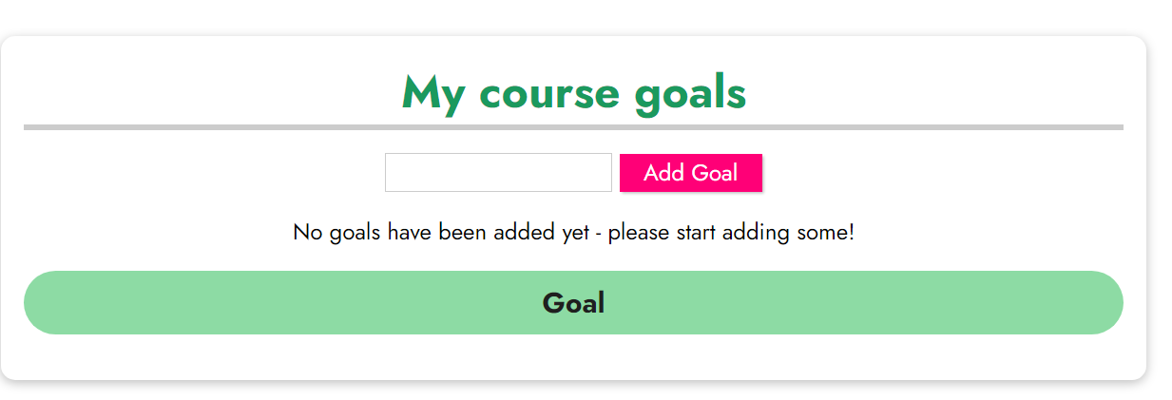
DEMO
1-demo- v-if
We want to show this only
if the list of goals is empty
10 MIN
CLASS

Slide 6
V-IF DIRECTIVE
<div v-if="students.length === 0">HELLO</div>
Added to DOM
If condition is true
Condition
(boolean expression)
Note: it’s not only HIDDEN, it is NOT added on the DOM !!

Slide 7

DISCUSSION
5 MIN
TEAM 2
V-IF
What is the difference between
V-SHOW
What is the meaning of
v-cloak
Search in team on internet
Demo with some code to understand

Slide 8
V-IF + V-ELSE DIRECTIVE
<div v-if="students.length === 0">
<p>Some content if condition true</p>
</div>
<div v-else>
<p>Some content if condition false</p>
</div>

Slide 9
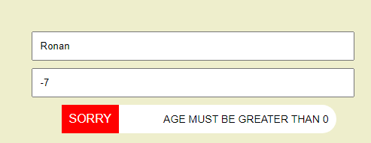
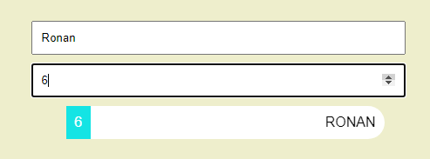
PRACTICE
Activity 1
20 MIN
INDIV
Display this if the age is lower than 0
Otherwise display the name

Slide 10
DEMO
3-demo- v-for
10 MIN
CLASS
We want to show the list of goals items

Slide 11
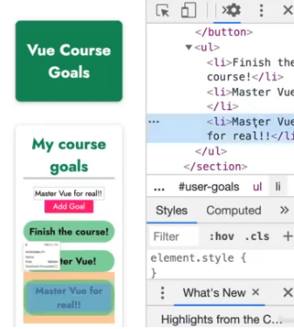
DEMO
Vue if optimized to render lists !
10 MIN
CLASS
Only this item is added
The other content does not change
If you click on Add button…

Slide 12
V-FOR DIRECTIVE
<p v-for=“item of items” :key=“item.id”> {{item.name}}</p>
Iteration
variable
Unique
key
<p>BANANA</p>
<p>MANGO</p>
<p>APPLE</p>

Slide 13
DISCUSSION
10 MIN
CLASS
What is the output of this ?
<p v-for="num in 4"> {{ num }}</p>

Slide 14
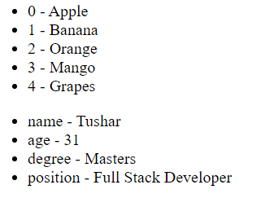
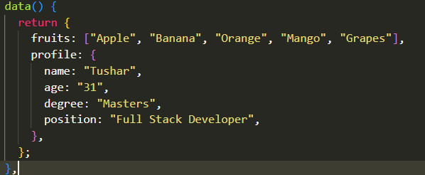
PRACTICE
Activity 3
5 MIN
INDIV
Display as below:
the list of fruit (with the index)
the list of profiles (with the key)

Slide 15
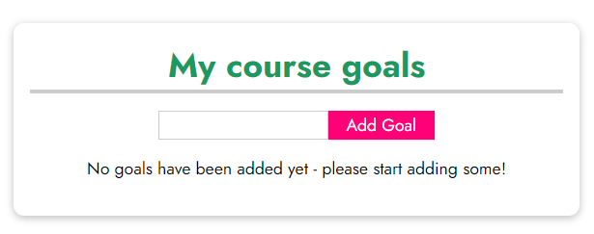
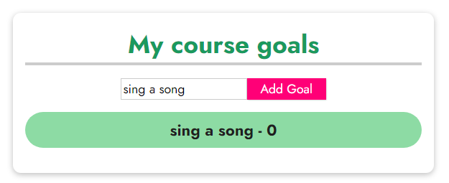
PRACTICE
ACTIVITY 4
20 MIN
INDIV
Start:
Click on Add Goal
Click on one goal item
(it remove the goal)

Slide 16

What you learnt
v-if
v-else
v-show
Render content conditionally
v-for
Loop on the template
V-cloak
Load Vue before displaying page

